Slide 1

FCI WM IGP 2024
Vinkovci, 25.09. – 29.09.2024

Slide 2


The Organisation
The Organisation committee
President of the Organising Committee: Martina Vučemilović
Expert Event Manager: Miran Marš
Head of Tracking: Blaženka Jovanović
In charge of the Stadium: Siniša Magdalenić

Slide 3
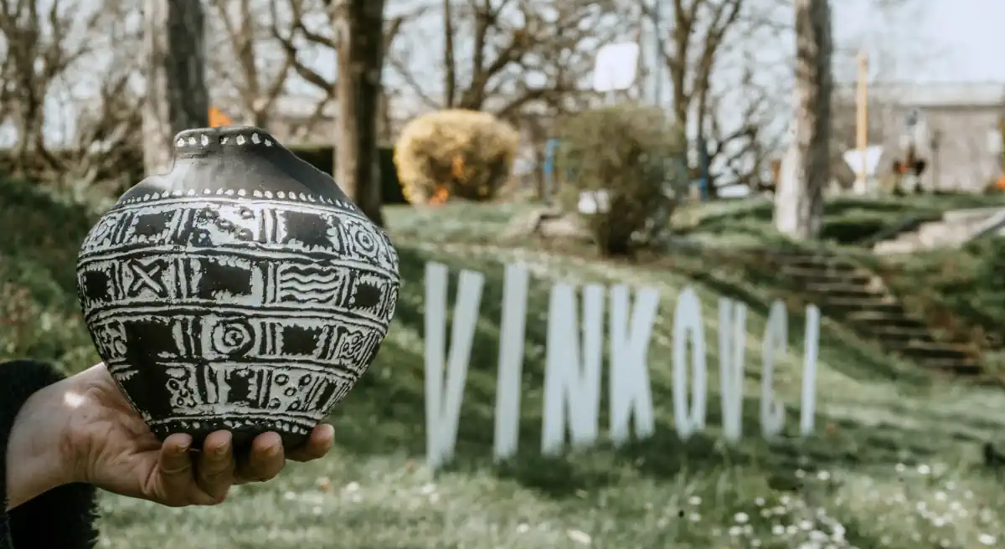


City of Vinkovci
a city in ”slavonia”, in the eastern part of Croatia, with a population around 30.000 people.
River Bosut that is running thru the city of Vinkovci, makes the city more appealing and very convenient
there are few hotels in the city center Hotel Slavonija***, Hotel Admiral***, Hotel Gem***
more Information regarding stay in Vinkovci and accommodation you can find under the Links below:
https://visitvinkovci.com/smjestaj/hoteli/ https://visitvinkovci.com/smjestaj/hosteli/ https://visitvinkovci.com/smjestaj/privatni-smjestaj/
also, in the surrounding area if on a search for an accommodation You can check on the following link:
https://www.visitvukovar-srijem.com/hr/smjestaj/

Slide 4
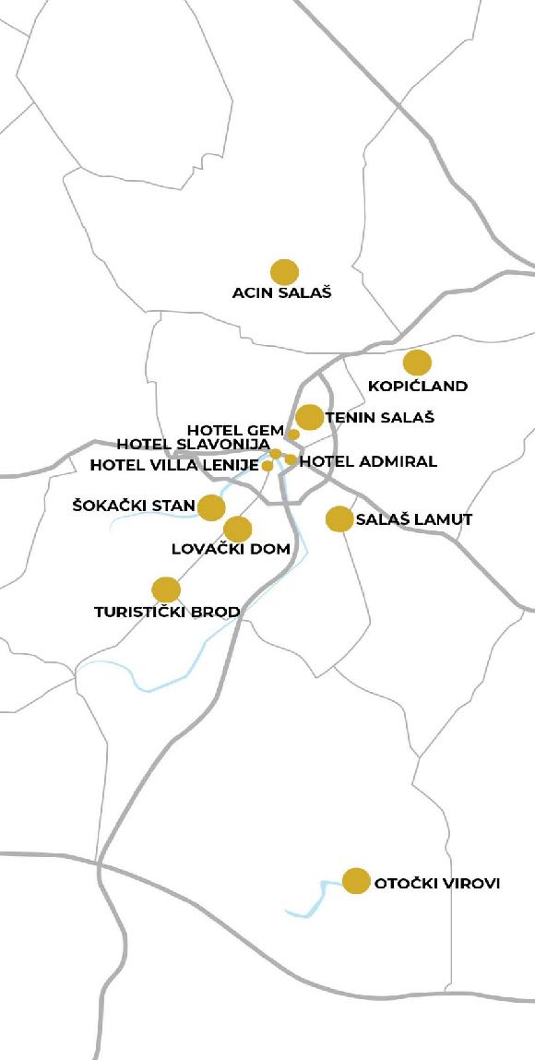
What to visit in Vinkovci?
The ideal places to turn back time and to enjoy the authentic culinary delights
Šokački stan
Salaš Lamut
Acin salaš
Tenin salaš
Kopićland
Otočki virovi
Turistički brod dr. Franje Tuđmana u općini Andrijaševci
Lovački dom Kunjevci

Slide 5
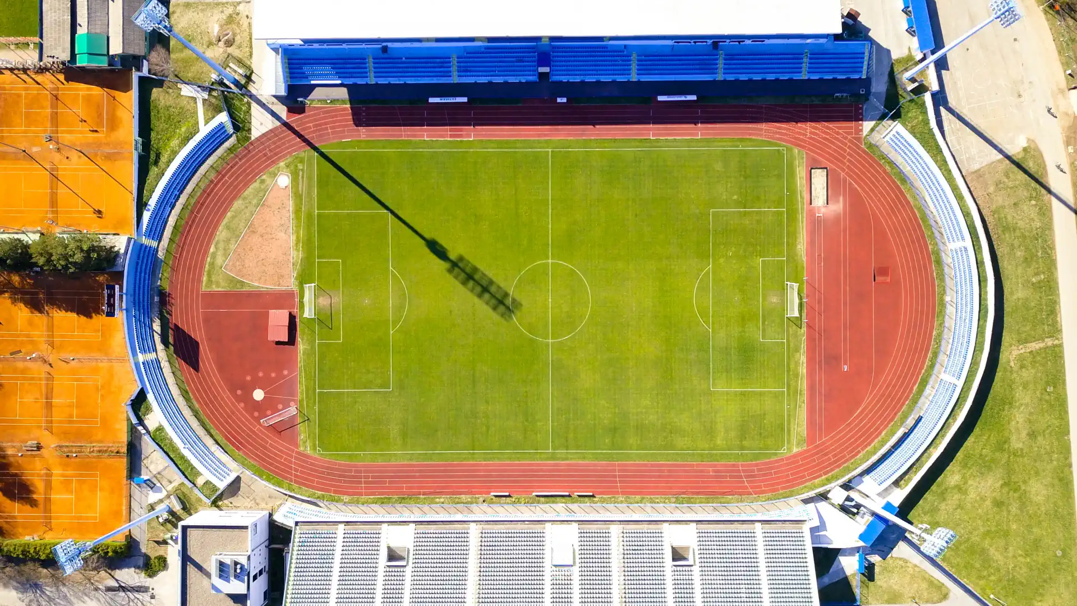
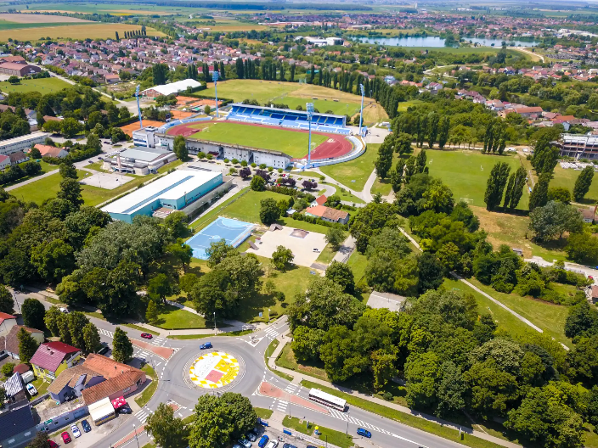
HNK Cibalia
the stadium is 10 min walk from the city center

Slide 6
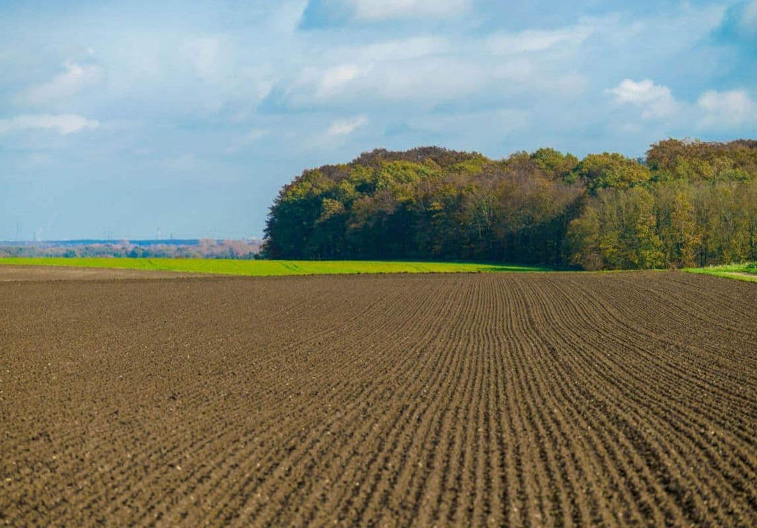
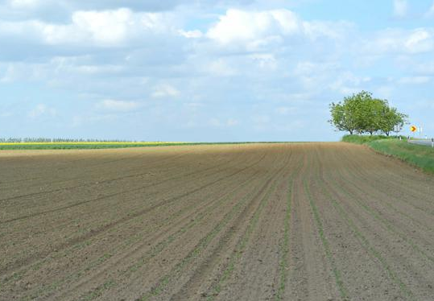
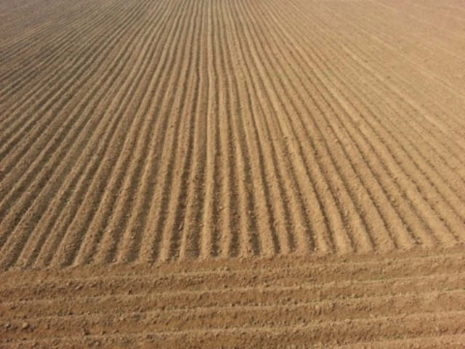
Tracking area
acers fields
the distance of the tracking fields from the main stadium will be in the range from 5 to 15 km

Slide 7
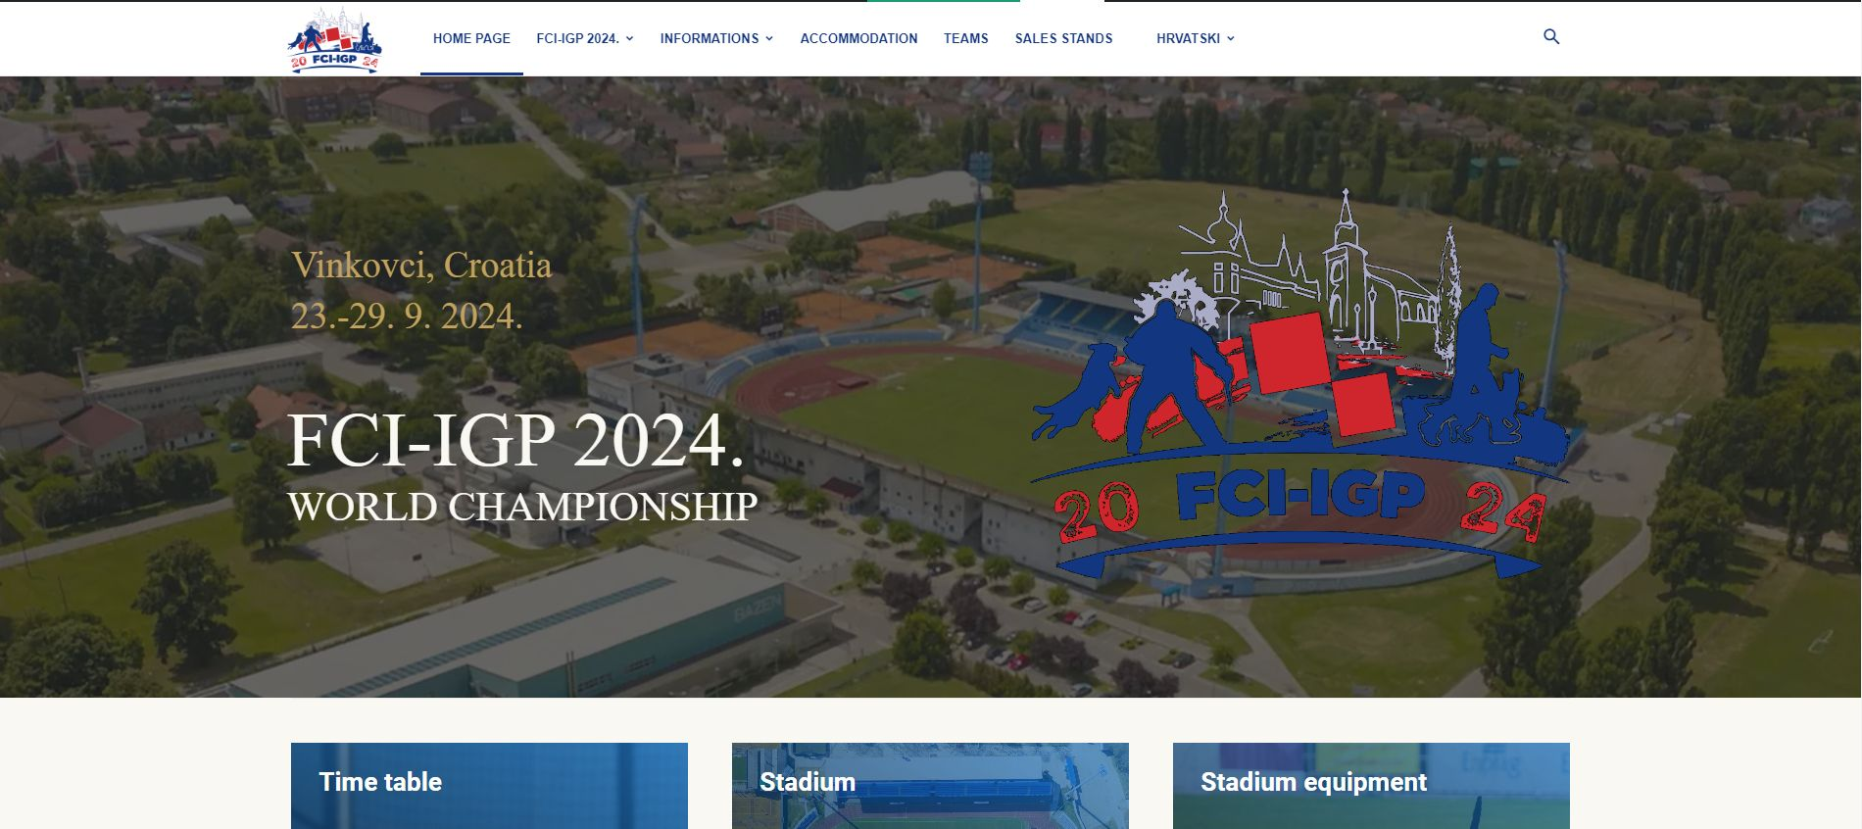
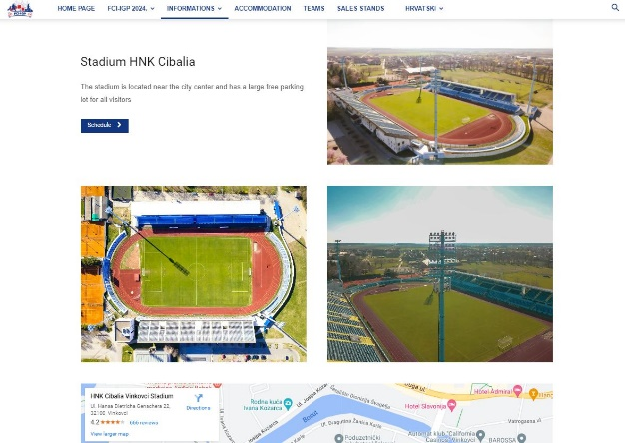
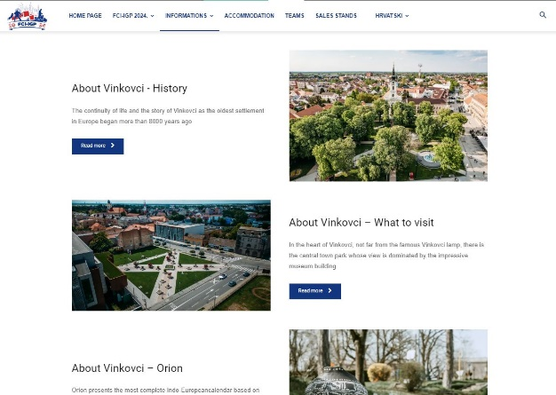
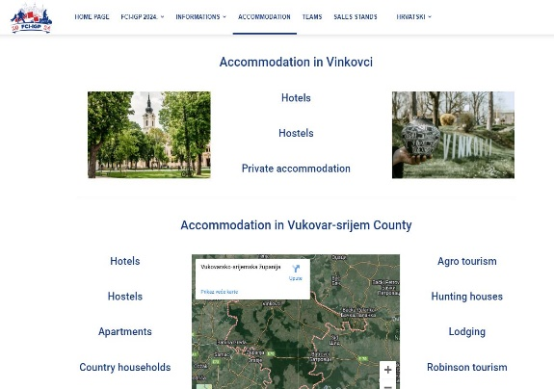
Web-page
with the official start on the 18.03.2024
Web page adress: https://fciigp2024.com/

Slide 8
Registration
Team/Country registration until 31. May 2024
Team members registration until 20. August 2024
Web page: https://fciigp2024.com/ (with the official start on the 18.03.2024)
Questions info@fciigp2024.com

